Slide 1
University of Connecticut
LooLoo Senior Design Project
Organization and Personnel

Slide 2
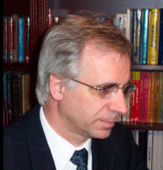
Management and Engineering Manufacturing (MEM)
Craig Calvert, MEM Co-Director
Frank Cunha MEM Staff
Craig Calvert, Faculty Advisor
Tianyu Zhu
Teaching Assistant
Logan Miller
Group Lead
Curtis Fetteroll
Randall Louie
Ahmed El-Mouwfi

Slide 3
Civil and Environmental Engineering (CEE)
Maria Chrysochoou CEE Director
Manish Roy, Faculty Advisor
TBD
Teaching Assistant
Alexa Wetmore
Zachary Lepore
Group Lead
Victoria Masucci
Stephanie Burns

Slide 4
Electrical and Computer Engineering (ECE)
John Chandy
ECE Director
Liang Zhang, Faculty Advisor
TBD
Teaching Assistant
Rudy Zhang, Team Lead
Tyler Rourke
Austin Caracciolo

